Slide 1
13
Return, Risk, and the Security Market Line
Prepared by Anne Inglis, Ryerson University
Notes:
11.<number>

Slide 2
Financial management for engineers Week 9: Summer 2019
Risk and return
13-<number>

Slide 3
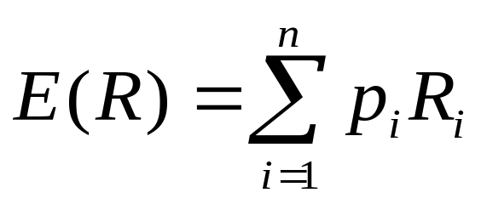
Expected Returns 13.1
LO1
Expected returns are based on the probabilities of possible outcomes
In this context, “expected” means average if the process is repeated many times
The “expected” return does not even have to be a possible return
13-<number>
Notes:
11.<number>
Use the following example to illustrate the mathematical nature of expected returns:
Consider a game where you toss a fair coin: If it is Heads then student A pays student B $1. If it is Tails then student B pays student A $1. Most students will remember from their statistics class that the expected value is $0 (=.5(1) + .5(-1)). That means that if the game is played over and over then each student should expect to break-even. Point out that the expected return of zero is not one of the possible outcomes. However, if the game is only played once, then one student will win $1 and one will lose $1.

Slide 4
Expected Returns – Example 1
LO1
Suppose you have predicted the following returns for stocks C and T in three possible states of nature. What are the expected returns?
  State Probability C T
  Boom 0.3 0.15 0.25
  Normal 0.5 0.10 0.20
  Recession ??? 0.02 0.01
R_{C} = .3(.15) + .5(.10) + .2(.02) = .099 = 9.9%
R_{T} = .3(.25) + .5(.20) + .2(.01) = .177 = 17.7%
13-<number>
Notes:
11.<number>
What is the probability of a recession? 0.2 Some students forget that the probabilities have to total to 1.0 or 100%.
If the risk-free rate is 6.15%, what is the risk premium?
Stock C: 9.99 – 6.15 = 3.84%
Stock T: 17.7 – 6.15 = 11.55%

Slide 5
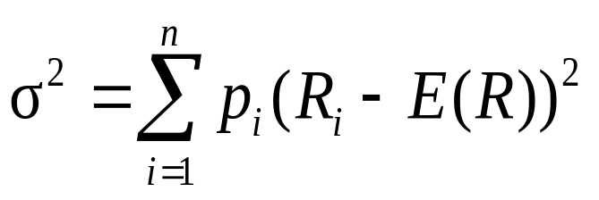
Variance and Standard Deviation
LO1
Variance and standard deviation still measure the volatility of returns
You can use unequal probabilities for the entire range of possibilities
Weighted average of squared deviations
13-<number>
Notes:
11.<number>
It’s important to point out that these formulas are for populations, unlike the formulas in chapter 12 that were for samples (dividing by n-1 instead of n).
Remind the students that standard deviation is the square root of the variance.

Slide 6
Variance and Standard Deviation – Example 1
LO1
Consider the previous example. What is the variance and standard deviation for each stock?
Stock C
  σ² = .3(.15-.099)² + .5(.1-.099)² + .2(.02-.099)² = .002029
  σ = .045
Stock T
  σ² = .3(.25-.177)² + .5(.2-.177)² + .2(.01-.177)² = .007441
  σ = .0863
13-<number>
Notes:
11.<number>

Slide 7
Portfolios 13.2
LO1
A portfolio is a collection of assets
An asset’s risk and return is important in how it affects the risk and return of the portfolio
The risk-return trade-off for a portfolio is measured by the portfolio expected return and standard deviation, just as with individual assets
13-<number>
Notes:
11.<number>

Slide 8
Example: Portfolio Weights
LO1
Suppose you have $15,000 to invest and you have purchased securities in the following amounts. What are your portfolio weights in each security?
  $2000 of ABC
  $3000 of DEF
  $4000 of GHI
  $6000 of JKL
ABC: 2/15 = .133
DEF: 3/15 = .2
GHI: 4/15 = .267
JKL: 6/15 = .4
13-<number>
Notes:
11.<number>
Show the students that the sum of the weights = 1

Slide 9
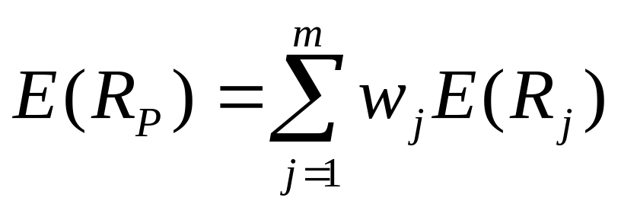
Portfolio Expected Returns
LO1
The expected return of a portfolio is the weighted average of the expected returns for each asset in the portfolio
You can also find the expected return by finding the portfolio return in each possible state and computing the expected value as we did with individual securities
13-<number>
Notes:
11.<number>

Slide 10
Example: Expected Portfolio Returns
LO1
Consider the portfolio weights computed previously. If the individual stocks have the following expected returns, what is the expected return for the portfolio?
  ABC: 19.65%
  DEF: 8.96%
  GHI: 9.67%
  JKL: 8.13%
E(R_{P}) = .133(19.65) + .2(8.96) + .267(9.67) + .4(8.13) = 10.24%
Click the Excel icon for an example
13-<number>
Notes:
11.<number>

Slide 11
Portfolio Variance
LO1
Compute the portfolio return for each state:
R_{P} = w₁R₁ + w₂R₂ + … + w_{m}R_{m}
Compute the expected portfolio return using the same formula as for an individual asset
Compute the portfolio variance and standard deviation using the same formulas as for an individual asset
13-<number>
Notes:
11.<number>

Slide 12
Example: Portfolio Variance
LO1
Consider the following information
  Invest 60% of your money in Asset A
  State Probability A B
  Boom .5 70% 10%
  Bust .5 -20% 30%
What is the expected return and standard deviation for each asset?
What is the expected return and standard deviation for the portfolio?
13-<number>
Notes:
11.<number>
If A and B are your only choices, what percent are you investing in Asset B?
Asset A: E(R_{A}) = .5(70) + .5(-20) = 25%
Variance(A) = .5(70+25)² + .5(-20-25)² = 2,025
Std. Dev.(A) = 45%
Asset B: E(R_{B}) = .5(10) + .5(30) = 20%
Variance(B) = .5(10-20)² + .5(30-20)² = 100
Std. Dev.(B) = 10%
Portfolio
Portfolio return in boom = .6(70) + .4(10) = 46%
Portfolio return in bust = .5(-20) + .5(30) = 0%
Expected return = .5(46) + .5(0) = 23 or
Expected return = .6(25) + .4(20) = 23
Variance of portfolio = .5(46-23)² + .5(0-23)² = 529
Standard deviation = 23%
Note that the variance is NOT equal to .5(2025) + .5(100) = 1062.5 and
Standard deviation is NOT equal to .5(45) + .5(10) = 27.5%

Slide 13
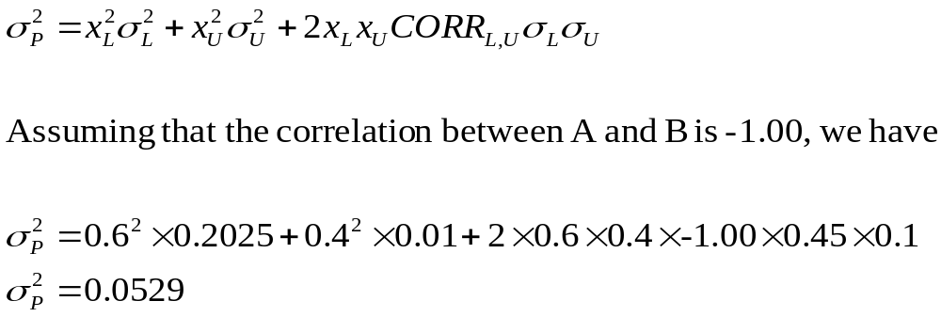
Another Way to Calculate Portfolio Variance
LO1
Portfolio variance can also be calculated using the following formula:
13-<number>
Notes:
11.<number>

Slide 14
Diversification
LO2
There are benefits to diversification whenever the correlation between two stocks is less than perfect (p < 1.0)
If two stocks are perfectly positively correlated, then there is simply a risk-return trade-off between the two securities.
13-<number>
Notes:
11.<number>

Slide 15
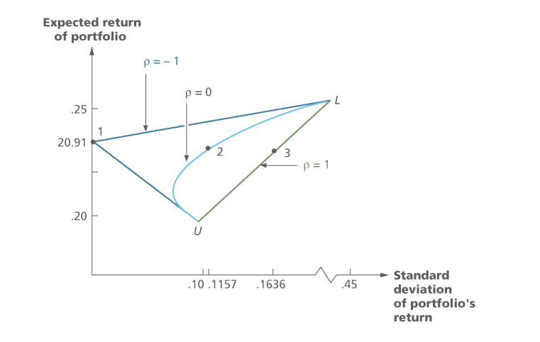
Diversification – Figure 13.4
LO2
13-<number>
Notes:
11.<number>

Slide 16
Expected versus Unexpected Returns 13.3
LO2
Realized returns are generally not equal to expected returns
There is the expected component and the unexpected component
  At any point in time, the unexpected return can be either positive or negative
  Over time, the average of the unexpected component is zero
13-<number>
Notes:
11.<number>

Slide 17
Announcements and News
LO2
Announcements and news contain both an expected component and a surprise component
It is the surprise component that affects a stock’s price and therefore its return
This is very obvious when we watch how stock prices move when an unexpected announcement is made or earnings are different than anticipated
13-<number>
Notes:
11.<number>

Slide 18
Efficient Markets
LO2
Efficient markets are a result of investors trading on the unexpected portion of announcements
The easier it is to trade on surprises, the more efficient markets should be
Efficient markets involve random price changes because we cannot predict surprises
13-<number>
Notes:
11.<number>

Slide 19
Systematic Risk 13.4
LO3
Risk factors that affect a large number of assets
Also known as non-diversifiable risk or market risk
Includes such things as changes in GDP, inflation, interest rates, etc.
13-<number>
Notes:
11.<number>

Slide 20
Unsystematic Risk
LO3
Risk factors that affect a limited number of assets
Also known as unique risk and asset-specific risk
Includes such things as labor strikes, shortages, etc.
13-<number>
Notes:
11.<number>

Slide 21
Returns
LO3
Total Return = expected return + unexpected return
Unexpected return = systematic portion + unsystematic portion
Therefore, total return can be expressed as follows:
Total Return = expected return + systematic portion + unsystematic portion
13-<number>
Notes:
11.<number>

Slide 22
Diversification 13.5
LO2
Portfolio diversification is the investment in several different asset classes or sectors
Diversification is not just holding a lot of assets
For example, if you own 50 internet stocks, you are not diversified
However, if you own 50 stocks that span 20 different industries, then you are diversified
13-<number>
Notes:
11.<number>

Slide 23
The Principle of Diversification
LO2
&
LO3
Diversification can substantially reduce the variability of returns without an equivalent reduction in expected returns
This reduction in risk arises because worse than expected returns from one asset are offset by better than expected returns from another
However, there is a minimum level of risk that cannot be diversified away and that is the systematic portion
13-<number>
Notes:
11.<number>

Slide 24
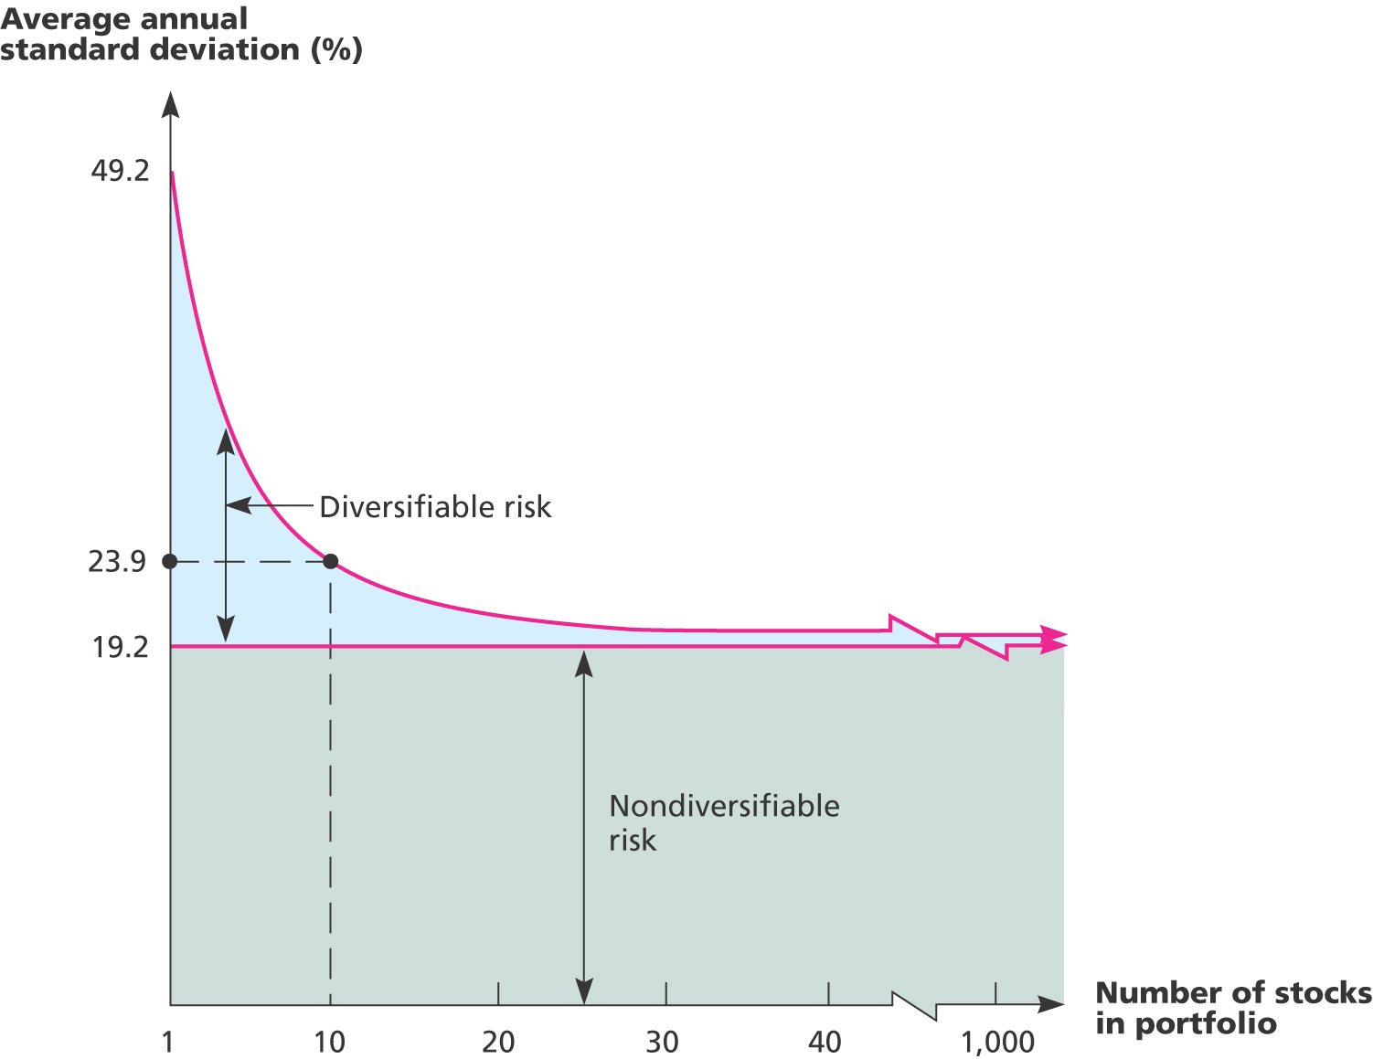
Figure 13.6 – Portfolio Diversification
LO2
&
LO3
13-<number>
Notes:
11.<number>

Slide 25
Diversifiable (Unsystematic) Risk
LO3
The risk that can be eliminated by combining assets into a portfolio
Synonymous with unsystematic, unique or asset-specific risk
If we hold only one asset, or assets in the same industry, then we are exposing ourselves to risk that we could diversify away
The market will not compensate investors for assuming unnecessary risk
13-<number>
Notes:
11.<number>

Slide 26
Total Risk
LO3
Total risk = systematic risk + unsystematic risk
The standard deviation of returns is a measure of total risk
For well diversified portfolios, unsystematic risk is very small
Consequently, the total risk for a diversified portfolio is essentially equivalent to the systematic risk
13-<number>
Notes:
11.<number>

Slide 27
Measuring Systematic Risk
LO3
How do we measure systematic risk?
  We use the beta coefficient to measure systematic risk
What does beta tell us?
  A beta of 1 implies the asset has the same systematic risk as the overall market
  A beta < 1 implies the asset has less systematic risk than the overall market
  A beta > 1 implies the asset has more systematic risk than the overall market
13-<number>
Notes:
11.<number>

Slide 28
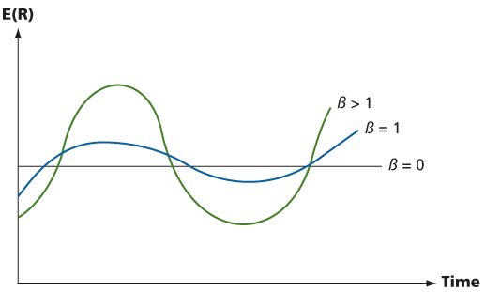
Figure 13.7 – High and Low Betas
LO3
13-<number>
Notes:
11.<number>

Slide 29
Example: Portfolio Betas
LO3
Consider the previous example with the following four securities
  Security Weight Beta
  ABC .133 3.69
  DEF .2 0.64
  GHI .267 1.64
  JKL .4 1.79
What is the portfolio beta?
.133(3.69) + .2(.64) + .267(1.64) + .4(1.79) = 1.773
13-<number>
Notes:
11.<number>
Which security has the highest systematic risk? ABC
Which security has the lowest systematic risk? DEF
Is the systematic risk of the portfolio more or less than the market? MORE

Slide 30
Beta and the Risk Premium 13.7
LO3
Remember that the risk premium = expected return – risk-free rate
The higher the beta, the greater the risk premium should be
Can we define the relationship between the risk premium and beta so that we can estimate the expected return?
  YES!
13-<number>
Notes:
11.<number>

Slide 31
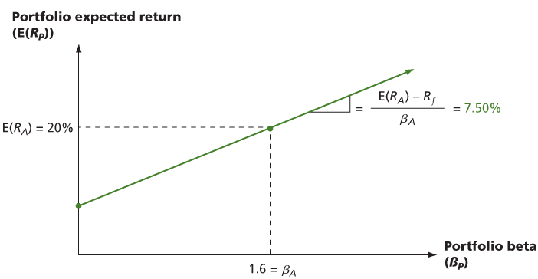
Figure 13.8A – Portfolio Expected Returns and Betas
LO4
R_{f}
13-<number>
Notes:
11.<number>
Based on the example in the book.
Point out that there is a linear relationship between beta and expected return. Ask if the students remember the form of the equation for a line.
Y = aX + b
E(R) = slope (Beta) + y-intercept
The y-intercept is = the risk-free rate, so all we need is the slope

Slide 32
Security Market Line
LO4
The security market line (SML) is the representation of market equilibrium
The slope of the SML is the reward-to-risk ratio: (E(R_{M}) – R_{f}) / β_{M}
But since the beta for the market is ALWAYS equal to one, the slope can be rewritten
Slope = E(R_{M}) – R_{f} = market risk premium
13-<number>
Notes:
11.<number>
Based on the discussion earlier, we now have all the components of the line:
E(R) = [E(R_{M}) – R_{f}]β + R_{f}

Slide 33
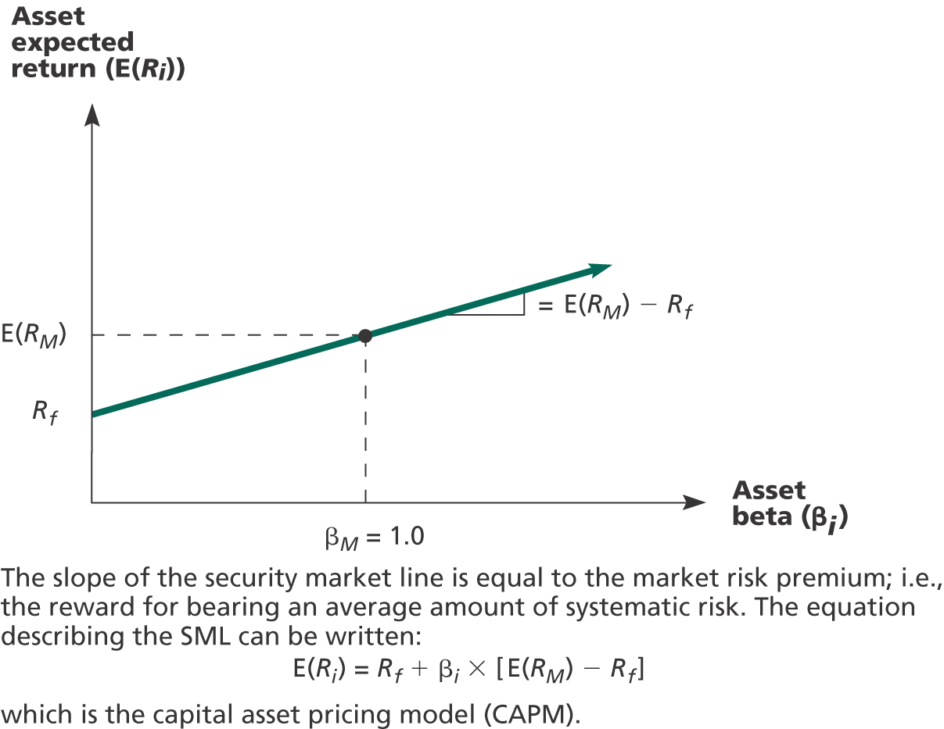
Figure 13.11 – Security Market Line
LO4
13-<number>
Notes:
11.<number>

Slide 34
The Capital Asset Pricing Model (CAPM)
LO4
The capital asset pricing model defines the relationship between risk and return
E(R_{A}) = R_{f} + β_{A}(E(R_{M}) – R_{f})
If we know an asset’s systematic risk, we can use the CAPM to determine its expected return
This is true whether we are talking about financial assets or physical assets
13-<number>
Notes:
11.<number>

Slide 35
Example - CAPM
LO4
Consider the betas for each of the assets given earlier. If the risk-free rate is 4.5% and the market risk premium is 8.5%, what is the expected return for each?
Security | Beta | Expected Return
ABC | 3.69 | 4.5 + 3.69(8.5) = 35.865%
DEF | .64 | 4.5 + .64(8.5) = 9.940%
GHI | 1.64 | 4.5 + 1.64(8.5) = 18.440%
JKL | 1.79 | 4.5 + 1.79(8.5) = 19.715%
13-<number>
Notes:
11.<number>

